Slide 1

Which news is fake?
Project 4
Metis Data Science Bootcamp
By Ouyang Yingzhao
Photo by Max Muselmann on Unsplash

Slide 2

Why should we care?
In the US:
Over half claim to regularly see fake news on sites such as Facebook or Twitter
Over a quarter rarely trusted the news that they read on social media
14 percent said that they have deliberately shared a fake political news story online
A SERIOUS PROBLEM!
Source: Fake News - Statistics & Facts by Amy Watson on Staista, May 5 2020
Image by S. Hermann & F. Richter from Pixabay

Slide 3
Objectives
Use a fake news dataset to predict which piece of news is fake...
…so that fake news can be blocked or signposted with warning labels

Slide 4
Methodology
Retrieve the data
Explore the data
Select our features and model
Evaluate the model

Slide 5
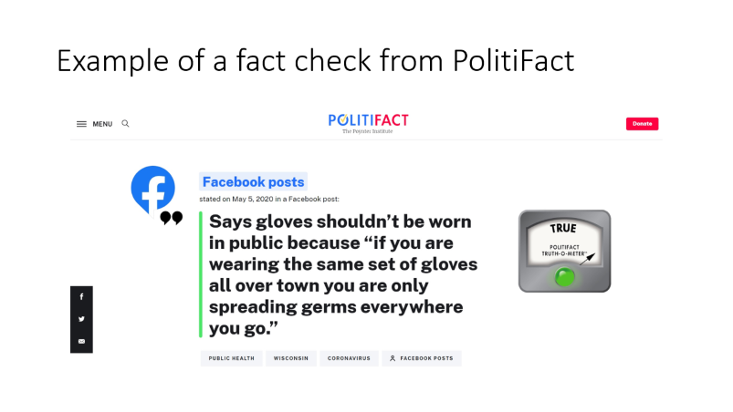
The LIAR dataset
Published by William Yang in July 2017 (source)
Dataset was retrieved by Yang from the PolitiFact.com API*
Statement dates are primarily between 2007 and 2016
* API is now defunct; Google FactCheck API has lots of missing statements in comparison

Slide 6
LIAR data files
5-fold cross-validation
File | Statements
train.tsv | 10,240
valid.tsv | 1,284
test.tsv | 1,267
Evaluate results and choose model
Judge final model

Slide 7

Retrieved 14 features
Column(s) | Description
id | The json ID of the statement
label | Truth value of the statement; 6 categories from ‘true’ to ‘pants on fire’
statement | Title of the PolitiFact article, often but not always the actual statement
subject | The subject(s) of the statement
speaker | The source of the statement
speaker_job speaker_us_state speaker_affiliation | The speaker’s job title, US state where they’re based, and party affiliation, where available
speaker_bt … speaker_pof (5 features) | Total count of truth values for the speaker (truth credit history), excluding ‘true’ count and including the current statement
context | The context (venue / location of the speech or statement)
Target feature is ‘label’
Ignoring truth credit history as features
Future knowledge would be included – big no-no
Need dates tagged to each statement to do a proper time-series analysis
Ignoring ‘speaker’ and US state, using other speaker-related features instead
via

Slide 8

Let’s explore the features!
Photo by Jamie Street on Unsplash

Slide 9
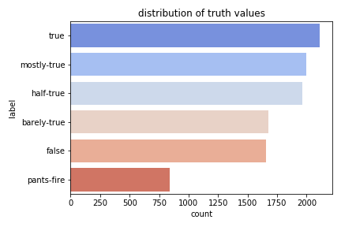

Truth values skew toward ‘true’ and ‘mostly-true’
Visualised with

Slide 10
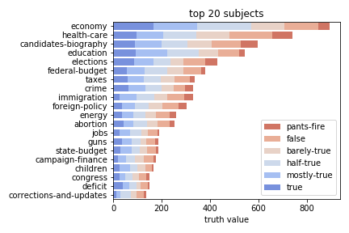
141 subjects in total
Distribution of truth values is similar per subject

Slide 11
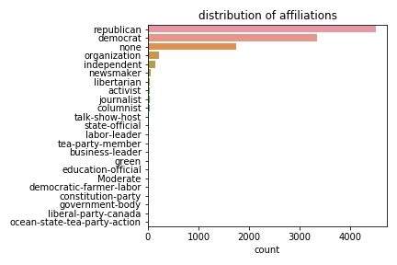
Speaker affiliations are mostly republican, democrat or none
19 other minor affiliations

Slide 12
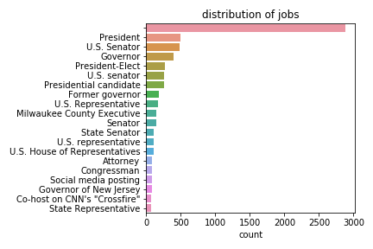
Lots of speaker jobs…
… 1,185 speaker jobs tagged for 2,910 unique speakers to be exact
However, 2,878 statements are tagged to ‘blank’ speaker jobs
More than a quarter of the dataset!

Slide 13
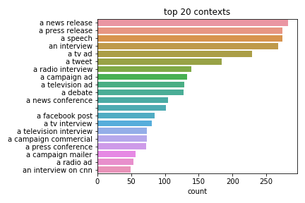
3,970 contexts in total

Slide 14
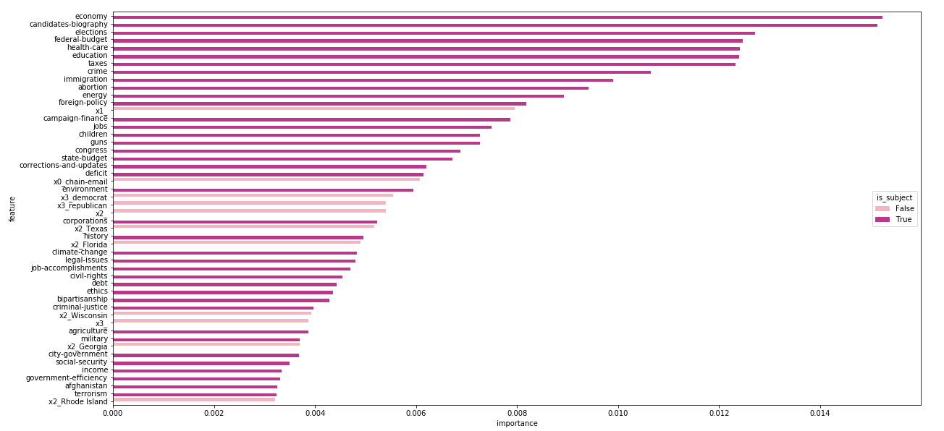
‘subject’ is the most important feature

Slide 15

Time to model!
Photo by Stephen Dawson on Unsplash

Slide 16



Methodology
Topic Modelling
Supervised Classification
Model statement, context and speaker_job…
…so as to cluster the three features into similar groupings
Classify fake news based on features, including generated topics

Slide 17

Topic modelling
For statement:
Non-Negative Factorization (20 or 50 topics) using:
Count Vectorizing with words only
Count Vectorizing with words and bigrams
TF-IDF Vectorizing with words only
For context and speaker_job:
Non-Negative Factorization (20 or 50 topics) using:
TF-IDF Vectorizing with words and bigrams
Combined and seperately:
Document embedding using:
Stanford’s GloVe
Selected

Slide 18
Features and targets considered
 | speaker_affiliation | speaker_job | subject | context | label
Original feature | X | X | X |  | X
Subset of feature |  |  | 20 most common, 20 most important |  | Transformed to ‘true’ and ‘false’ only
Topic modelling |  | X | Based on statement | X
Types of features considered
Features and targets selected
Types of targets considered

Slide 19
Classification models considered
Random Forest
Randomized search (20 iterations)
Multinomial Naïve Bayes
Grid search
Selected

Slide 20
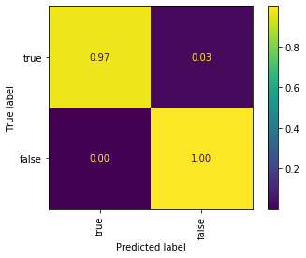
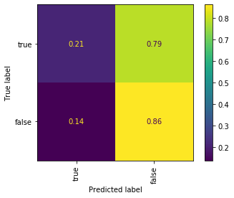
Final model
Train
Best model
Random Forest
f1 score on train dataset
0.58
Over-fitting
Evaluation

Slide 21

Why?
‘Statement’ is the headline of the PolitiFact.com article, and does not always reflect the actual content of the fake news
Lack of dates translate to lack of historical information
Prevalence of missing speaker jobs and affiliations
“The [LIAR] dataset … is considered hard to classify due to lack of sources or knowledge bases to verify with”
Gosh and Shah, 2019
Photo by Sebastian Herrmann on Unsplash

Slide 22
Future work
Supplement with other fake news datasets or API’s
Apply different models e.g. gradient boosting or recurrent neural networks
Use more advanced NLP tools, e.g. part-of-speech analysis, BERT

Slide 23


To contact me:
Yingzhao Ouyang
Data Scientist
https://www.linkedin.com/yzouyang
https://www.medium.com/@yzouyang

Slide 24
Appendix

Slide 25
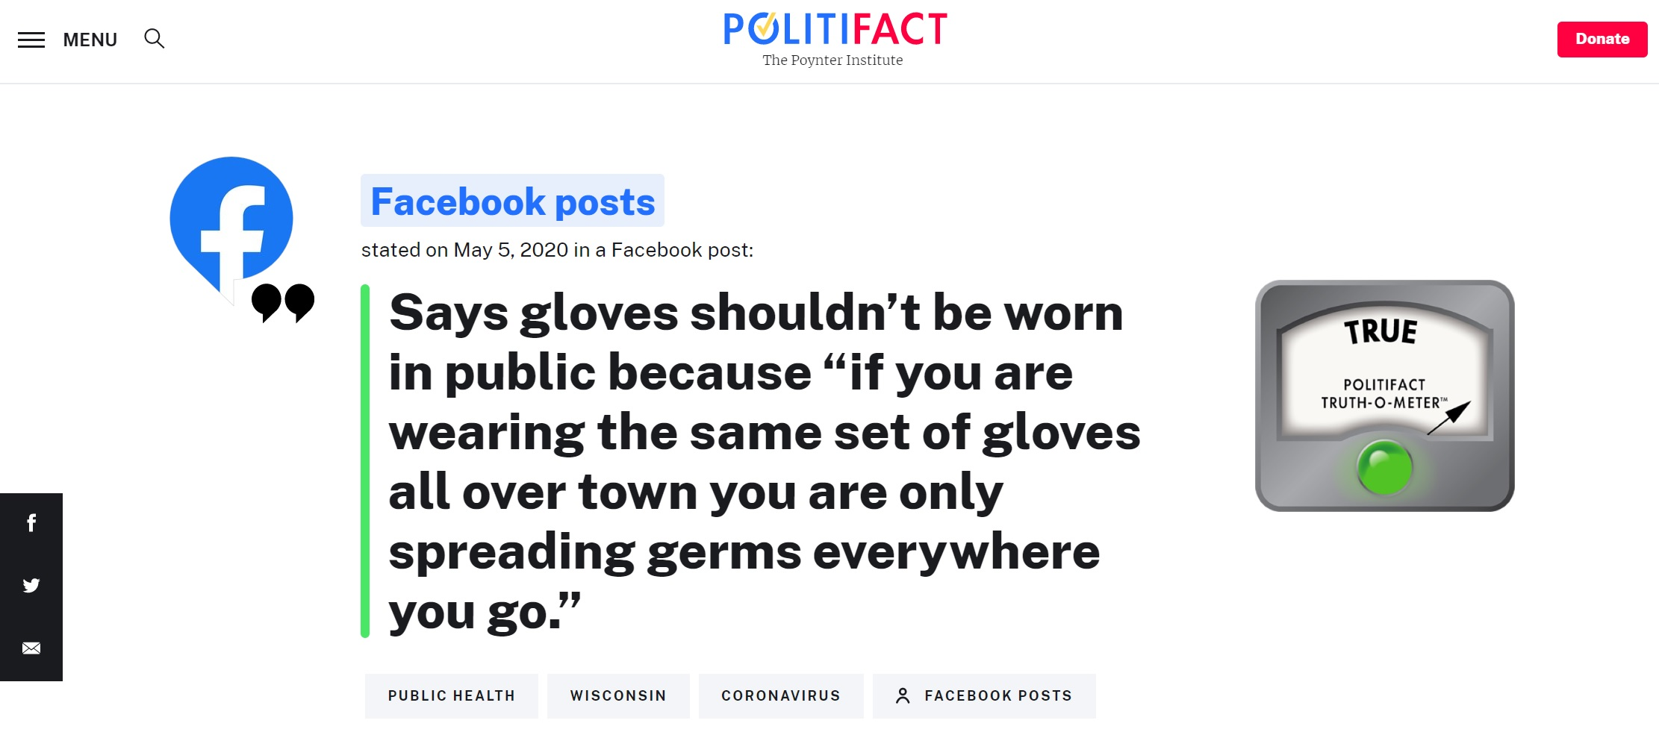
Example of a fact check from PolitiFact

Slide 26
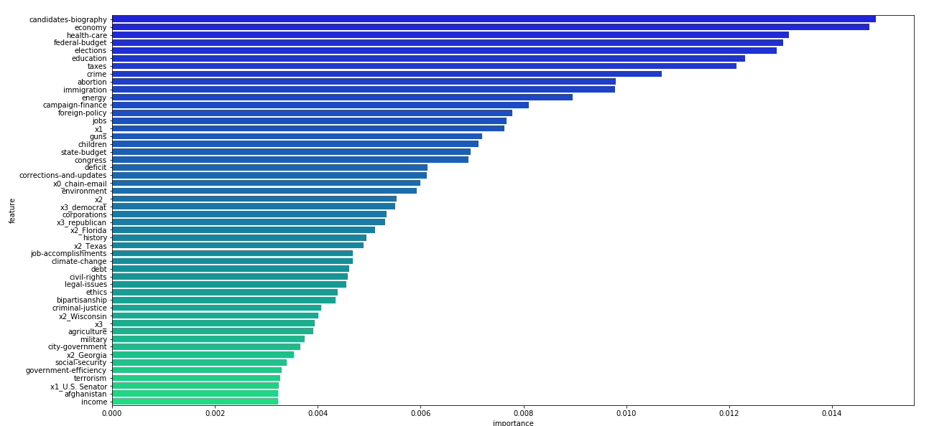

Slide 27
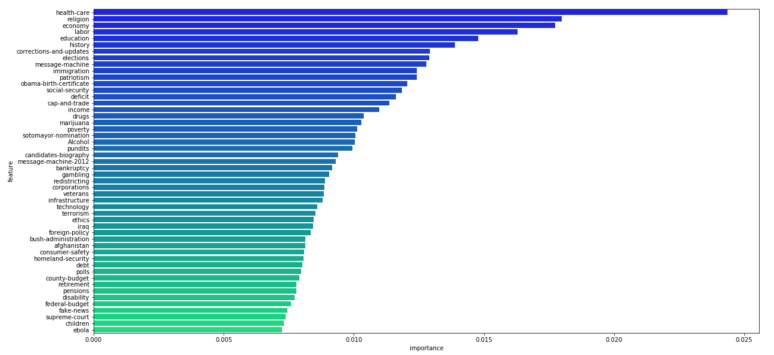

Slide 28
